Slide 1
Computer Network Traffic Data
Result
Communication
Process &
Analysis
Data
Collection
Business
Questions
20 November 2019 @ Telus

Slide 2


Next 20 minutes
Questions
Data
Methods
Results
Discussion
Conclusion

Slide 3


Questions
"odd" activity/suspicions about a machine's behavior:
Date : IP
08-24 : 1
09-04 : 5
09-18 : 4
09-26 : 3 6
When were the devices compromised by bot activity? Or when a compromise has occurred by a change in the pattern of communication?

Slide 4
2. Data
Computer Network Traffic Data with:
A ~500K CSV of some historical real network traffic data
10 local workstation IPs over a three month period
Half of the IPs were compromised
~21K rows
Four columns: ‘date’, ‘l_ipn’, ‘r_asn’, and ‘f’

Slide 5







3. Methods
Collect
Clean
Transform
Analyze
Present

Slide 6


4. Results
Tableau public:
https://public.tableau.com/profile/peter.le6443#!/vizhome/ComputerNetworkTrafficData/OverallClusters
Github:
https://github.com/peterquynhle/Computer-Network-Traffic-Data

Slide 7
4. Results (1)
Columns | Description | Range | Null
Date | yyyy-mm-dd | Jul-Sept 2006 | No
l_ipn | local IP | 0-9 | No
r_asn | remote ASN | 2005 | No
f | flows – i.e., count of connections by day | 1 - 784,234 | No

Slide 8
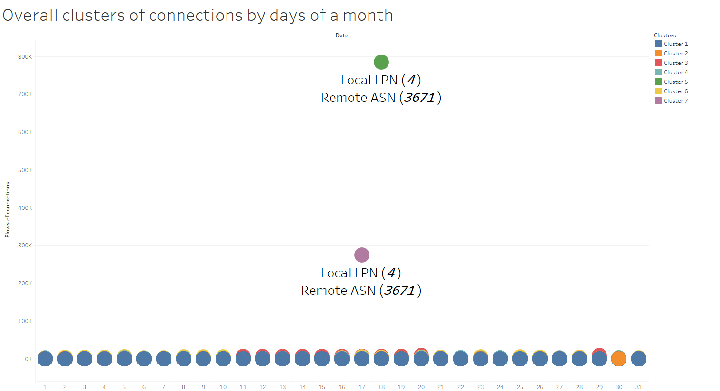
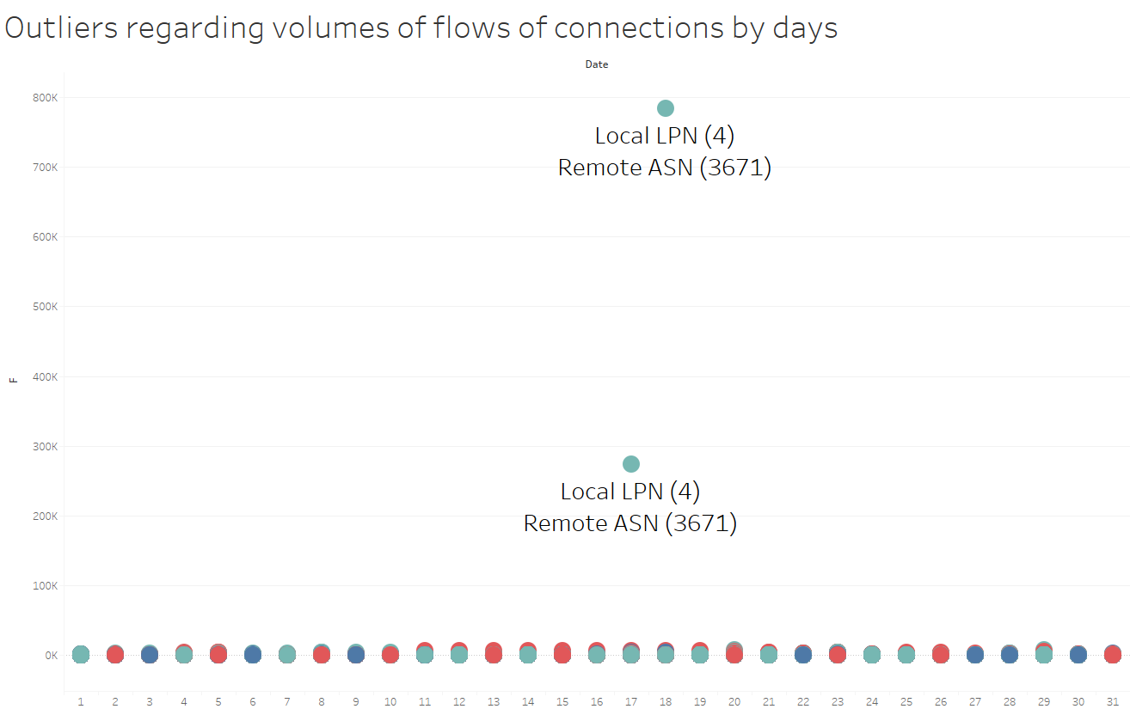
4. Results (2)

Slide 9
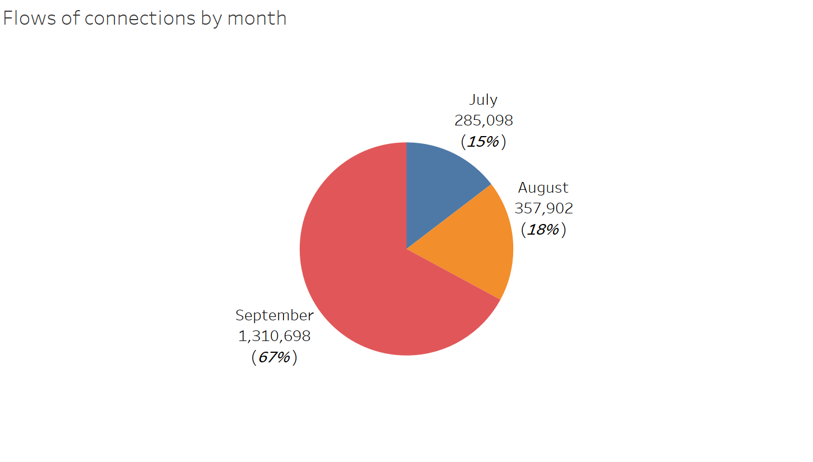
4. Results (3)

Slide 10
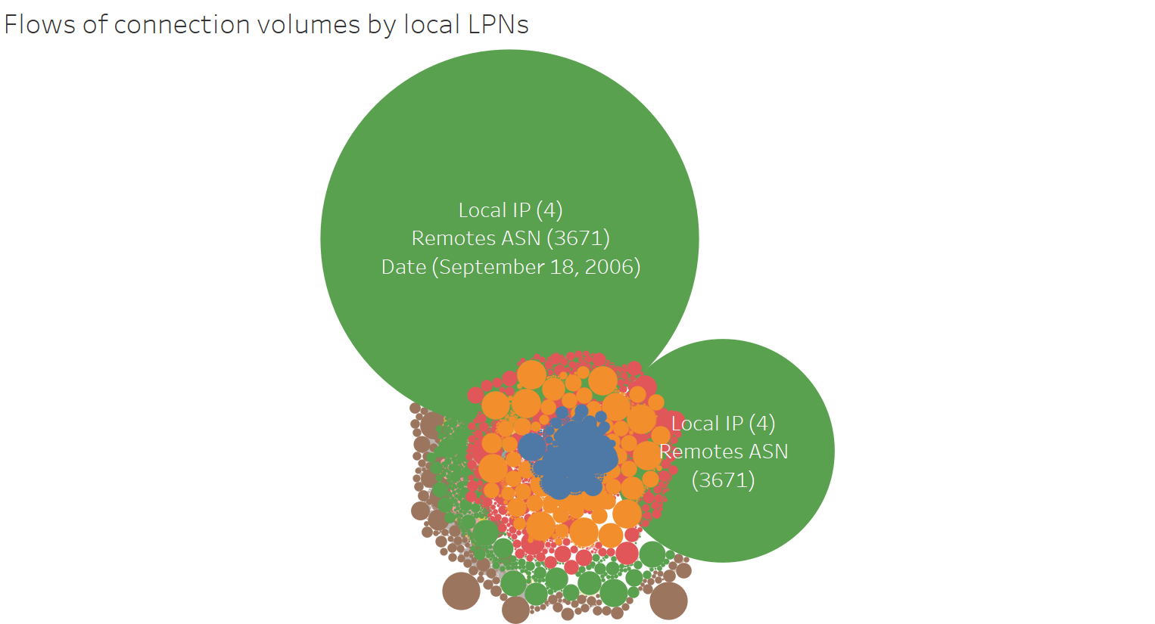
4. Results (4)

Slide 11
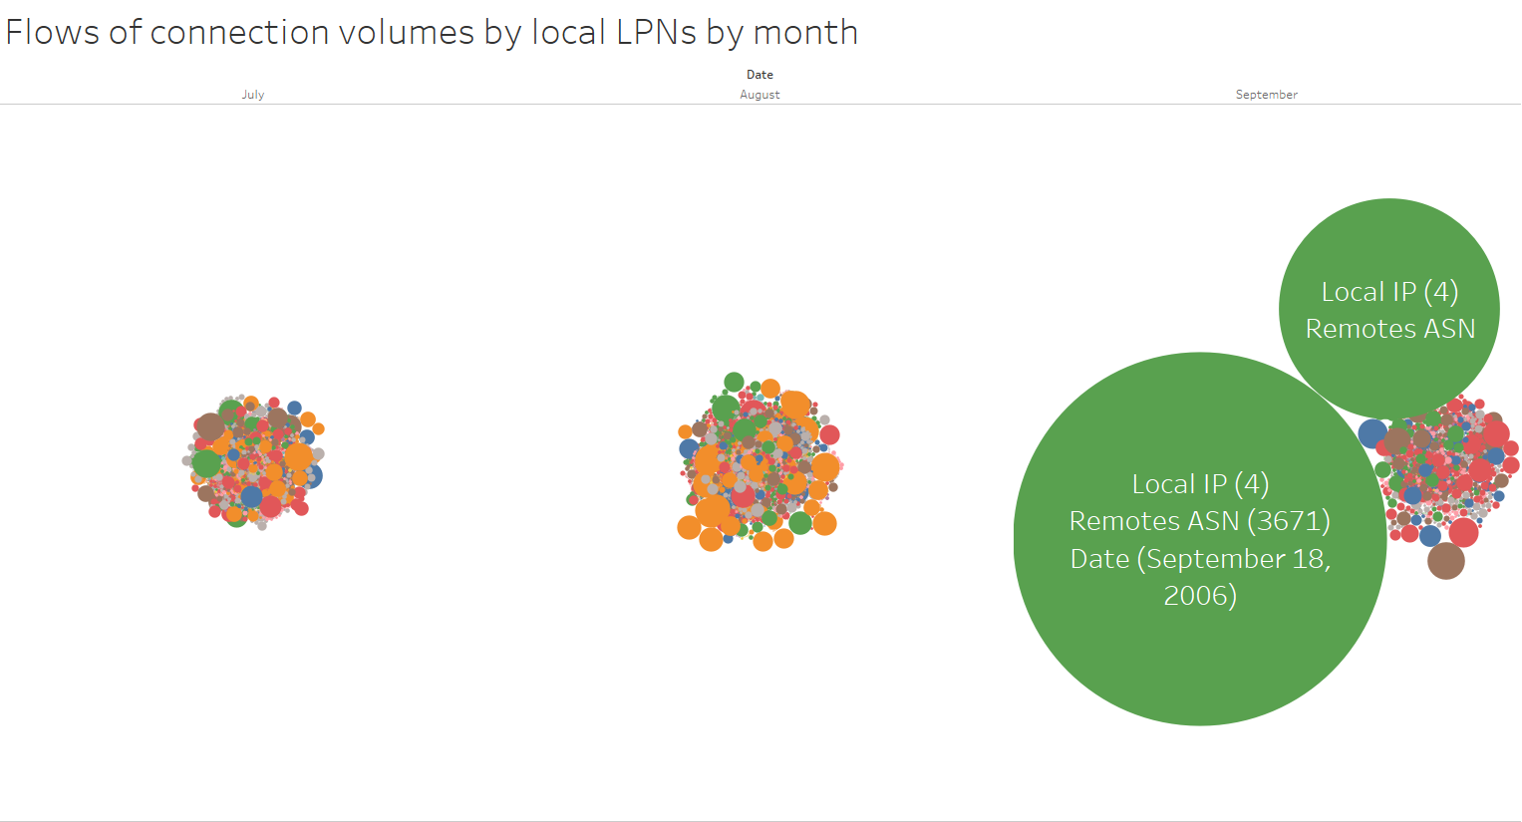
4. Results (5)

Slide 12
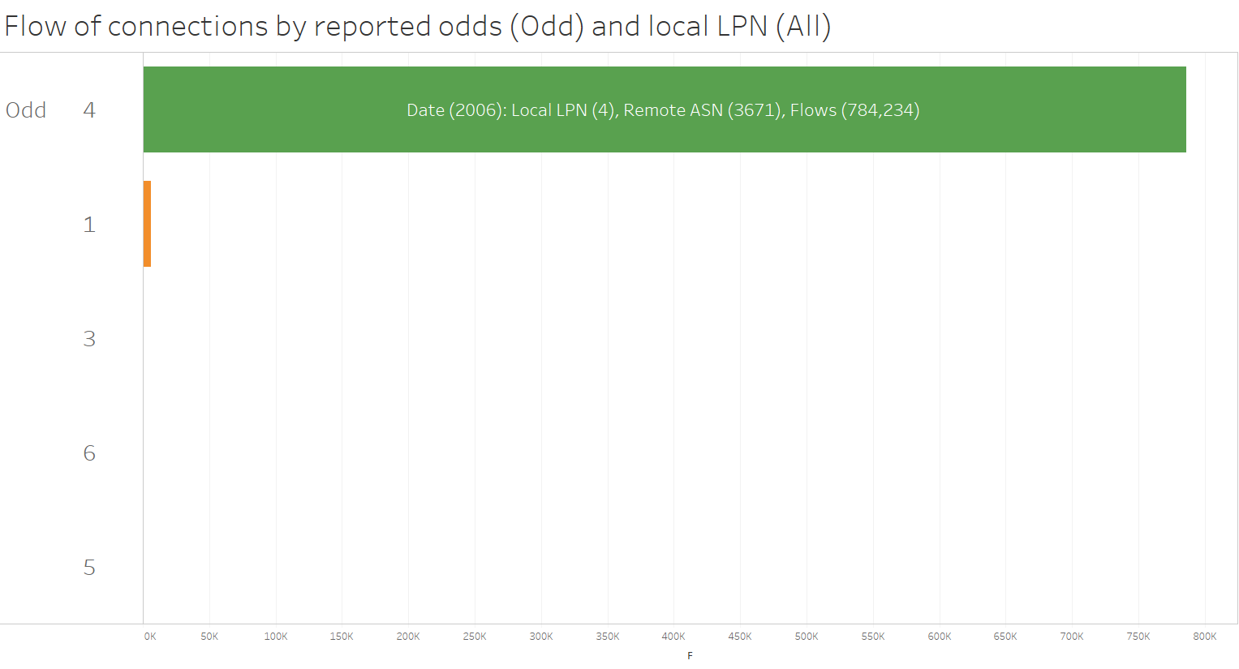
4. Results (6)

Slide 13
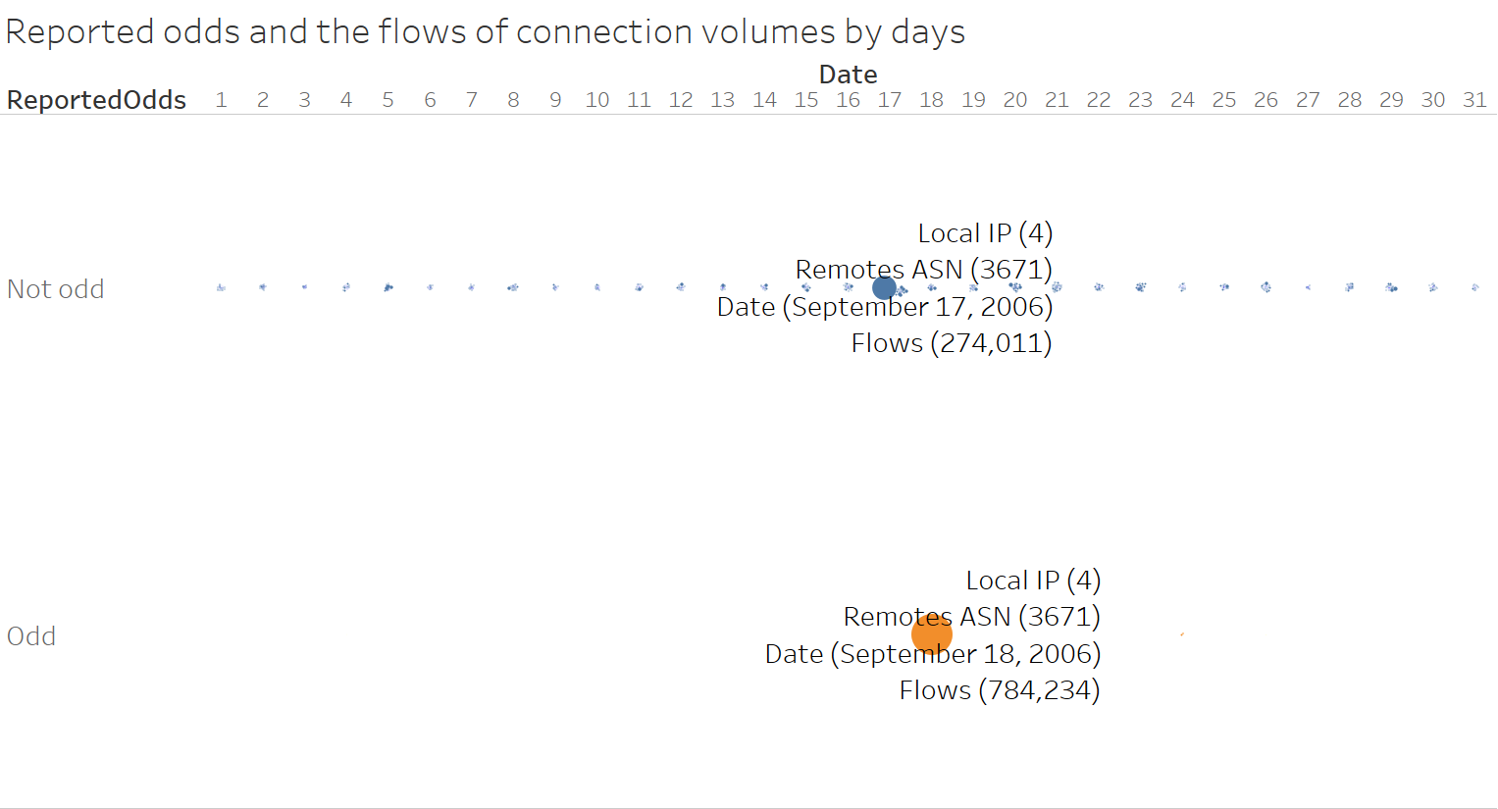
4. Results (7)

Slide 14
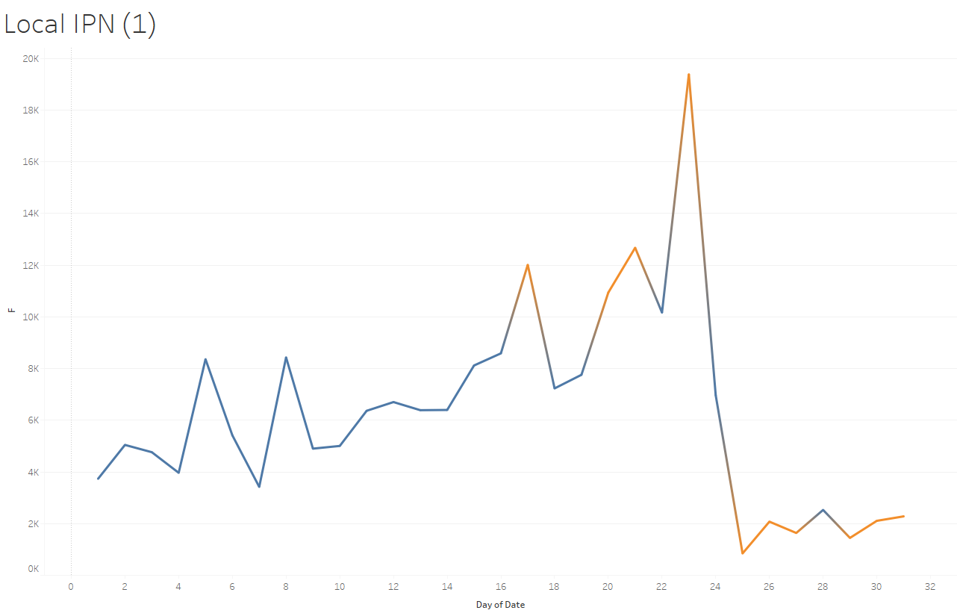
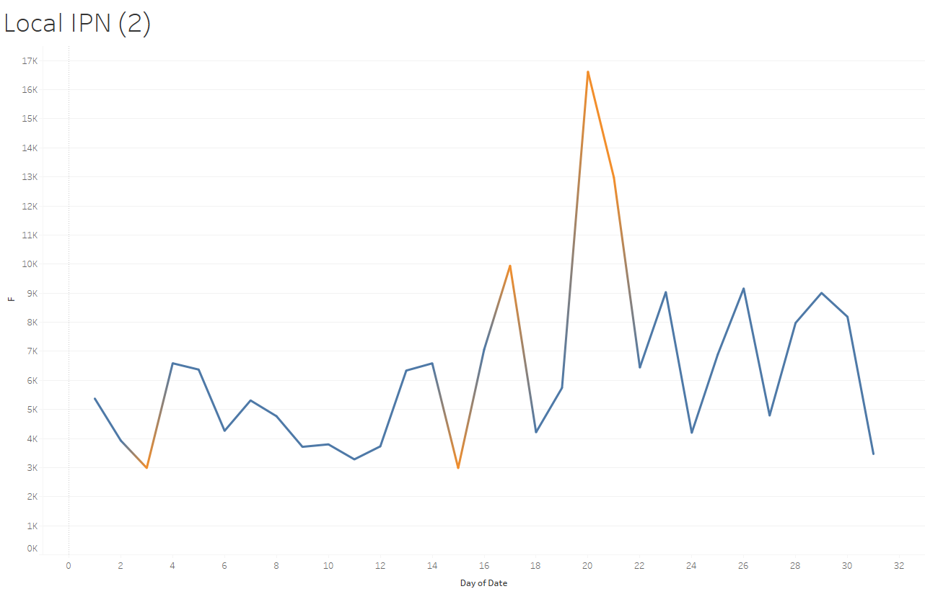
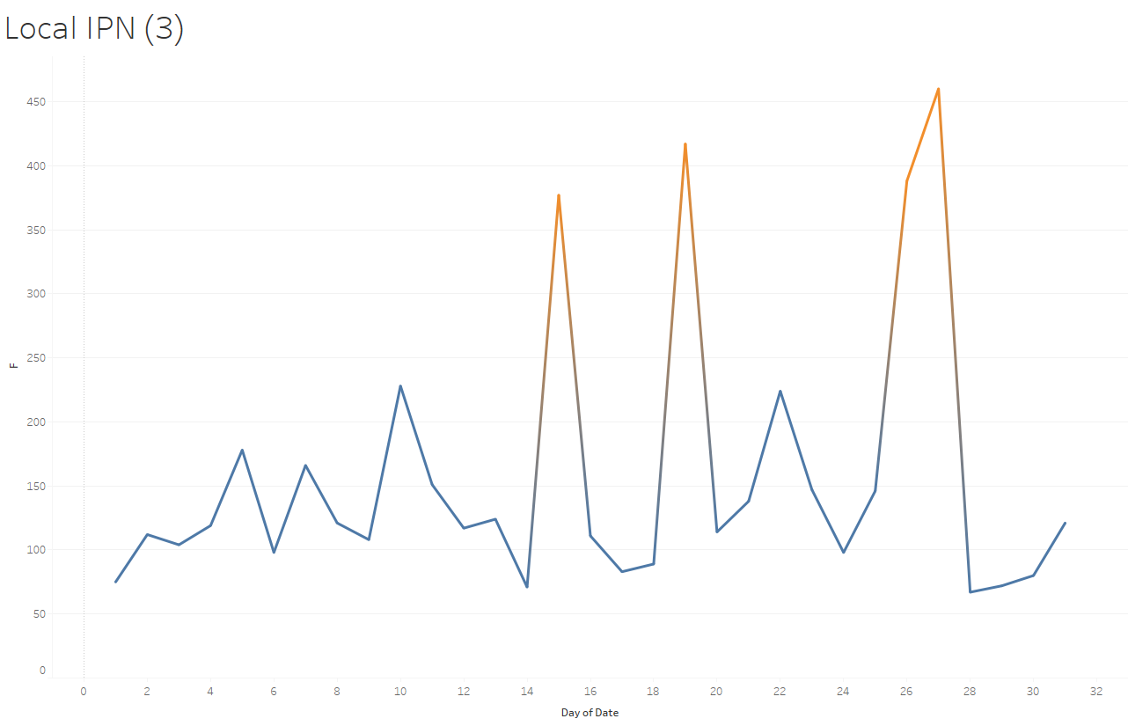
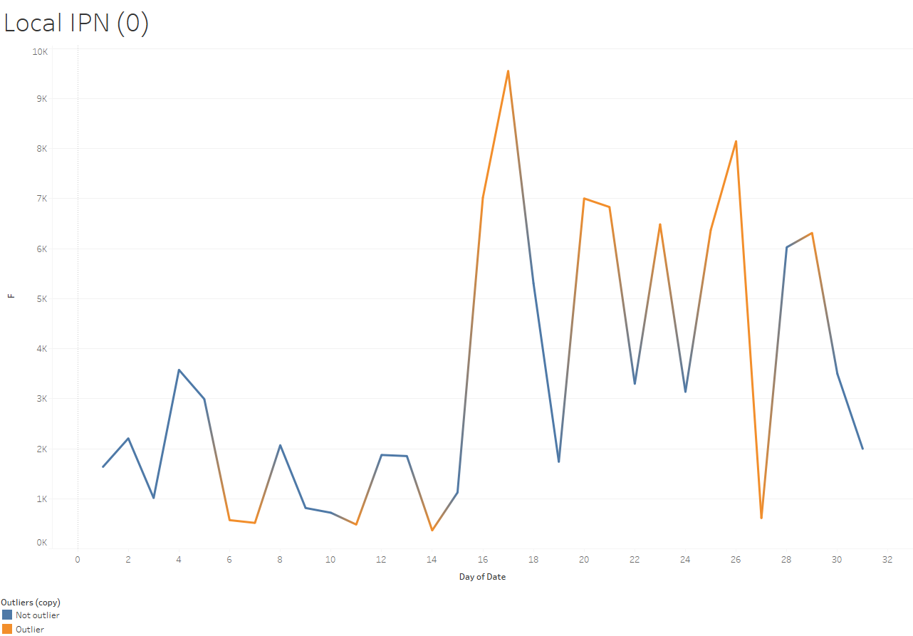
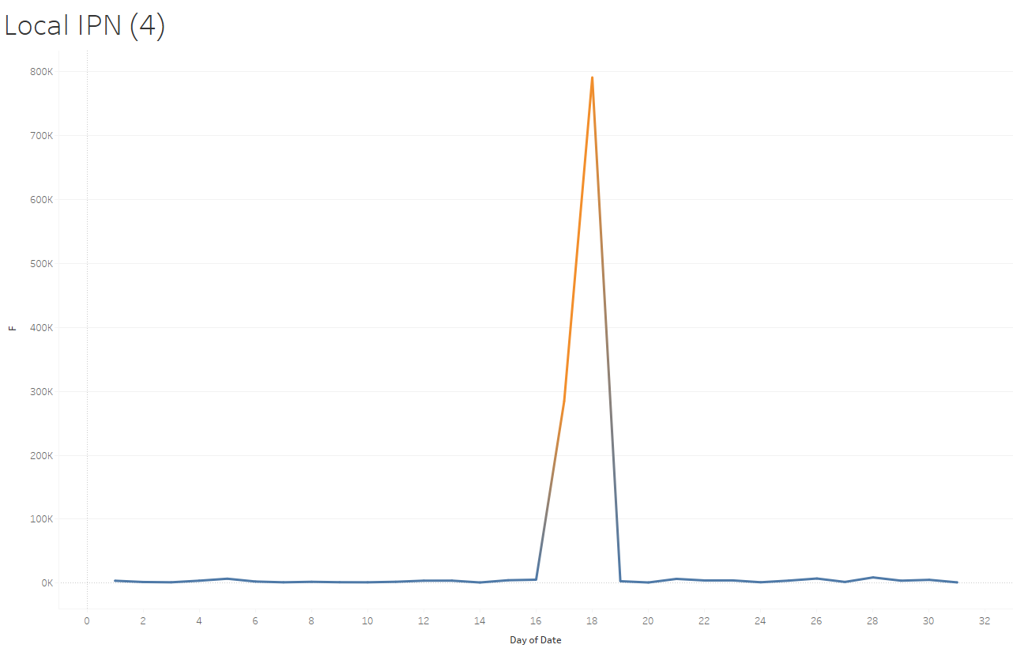
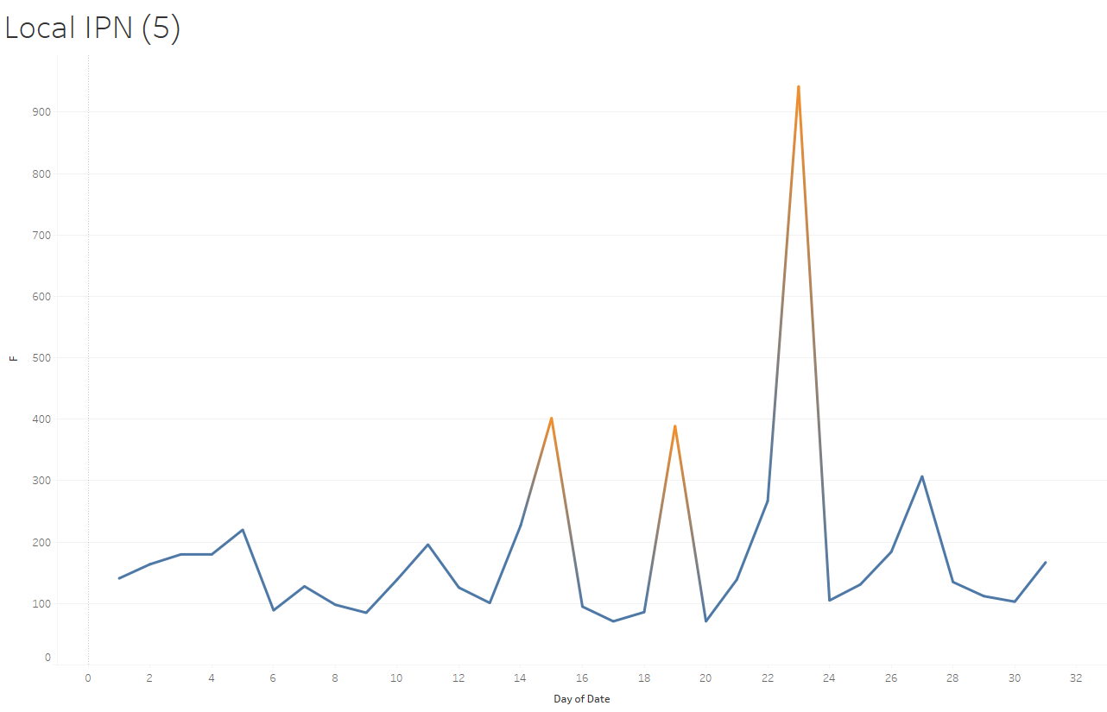
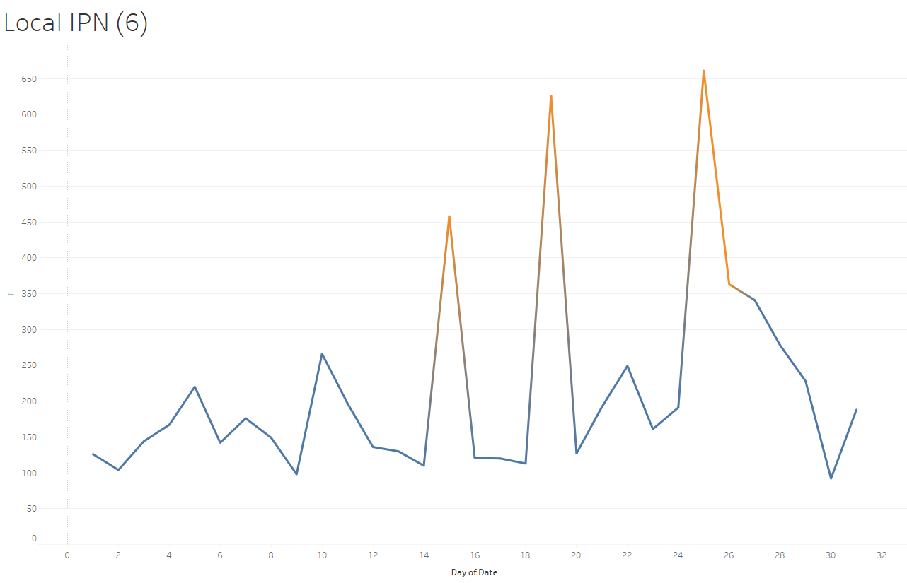
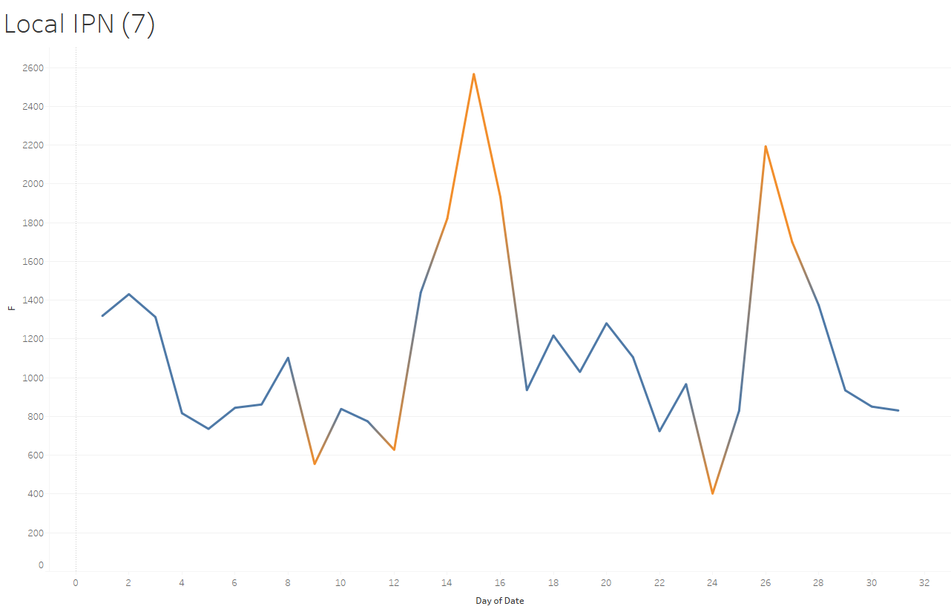
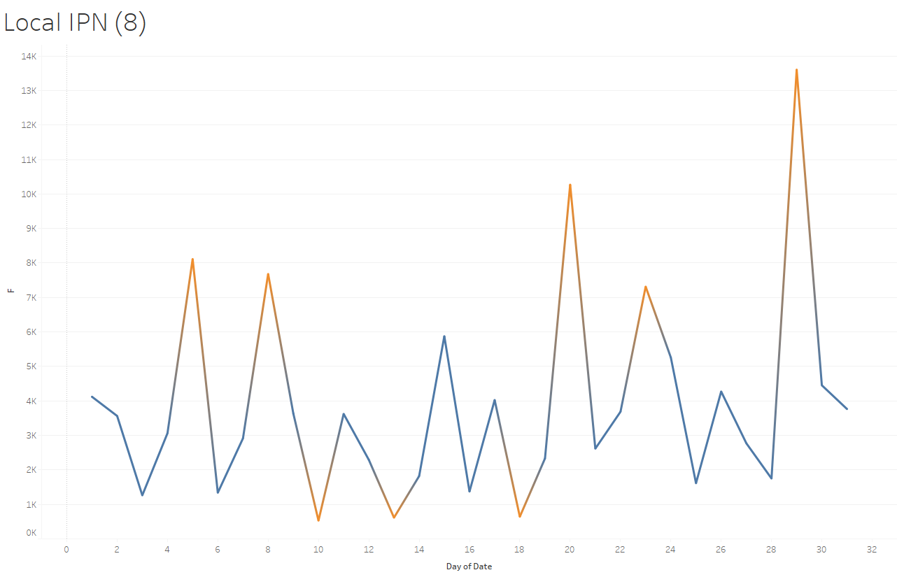
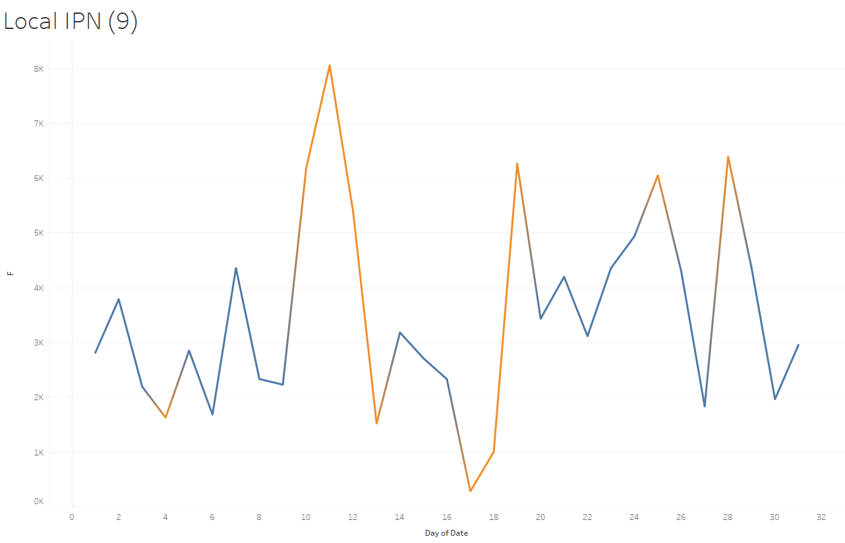
4. Results (8) - Outliers by days and local IPNs

Slide 15
5. Discussion
Overall: All local IPs have outliers by days, especially:
Local IP: 4 and possible 1
Date: Sept 17, 18, possible Jul 1 & Aug 1
Remote ASN: 3671
Flow: 274,011 & 784,234
Among the reported odds:
Local IP: 4
Remote ASN: 3671
Date: Sept18, 2006
Flow: 784,234

Slide 16

6. Conclusion
Result
Communication
Process &
Analysis
Data
Collection
Business
Questions
It is very likely that the local IP (4) had been compromised by bot activity on September 17 and 18. In addition, local PI (1) might also be compromised on Jul 1 & Aug 1. More detailed investigations are required to confirm compromised bot activities in all other local IPs.

Slide 17
Thanks for your time!

